Slide 1
Centroid of Plane Areas
Centre of Gravity of Area/Laminas

Slide 2
Definitions
Centre of Gravity (CG)
The CG of a body can be defined as a point in it, at which the resultant of gravitational forces is concentrated
CG of a body is related to the distribution of weight of the body
Centroid of Plane area (G)
Centroid is a point at which the entire area of an object is assumed to be concentrated.
It is also defined as a point of geometric center of a composite area or an object.
The centroid is noted by C.G or G (G is more appropriate)
An object of uniform thickness and density would have its weight uniformly distributed over the entire are
In such a case, locating the centre of gravity would reduce to finding the centroid of the area of the object, ignoring its weight (i.e. its thickness and density)

Slide 3
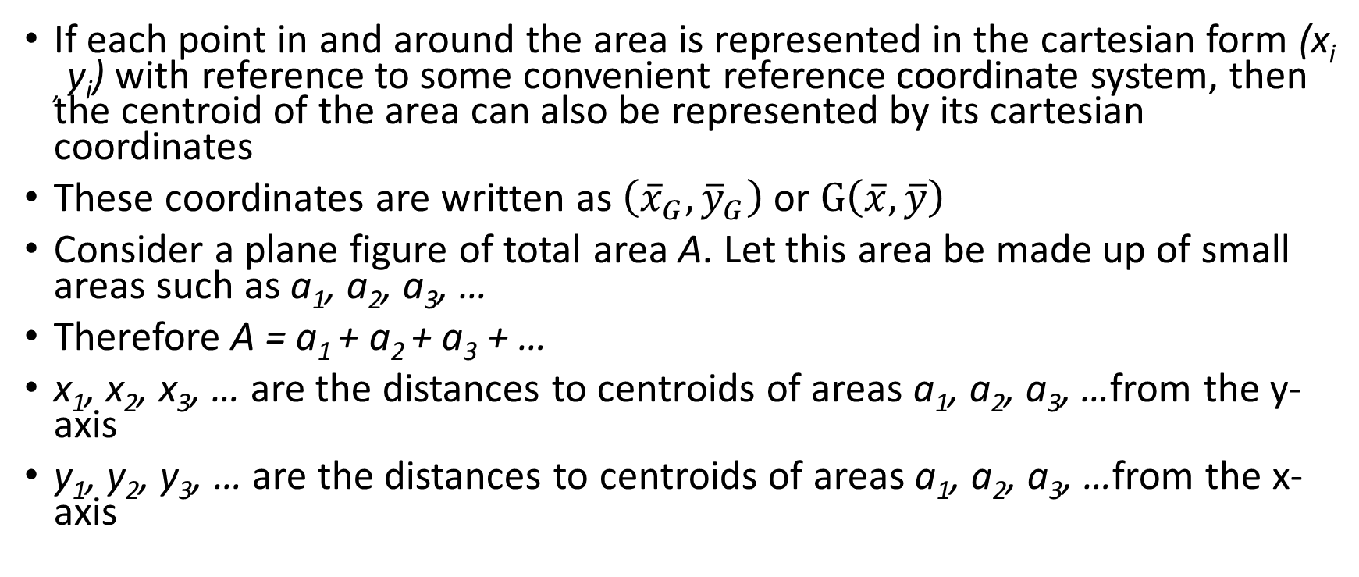
Locating the Centroid of an area (lamina)
If each point in and around the area is represented in the cartesian form (x_{i ,} y_{i}) with reference to some convenient reference coordinate system, then the centroid of the area can also be represented by its cartesian coordinates
These coordinates are written as $\left({\overline{x}}_{G}, {\overline{y}}_{G}\right)$ or $G\left(\overline{x}, \overline{y}\right)$
Consider a plane figure of total area A. Let this area be made up of small areas such as a₁, a₂, a₃, …
Therefore A = a₁ + a₂ + a₃ + …
x₁, x₂, x₃, … are the distances to centroids of areas a₁, a₂, a₃, …from the y-axis
y₁, y₂, y₃, … are the distances to centroids of areas a₁, a₂, a₃, …from the x-axis

Slide 4
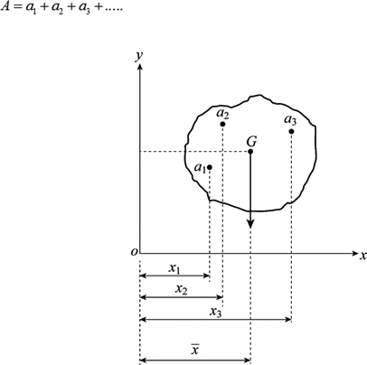
Locating the Centroid of an area (lamina)

Slide 5
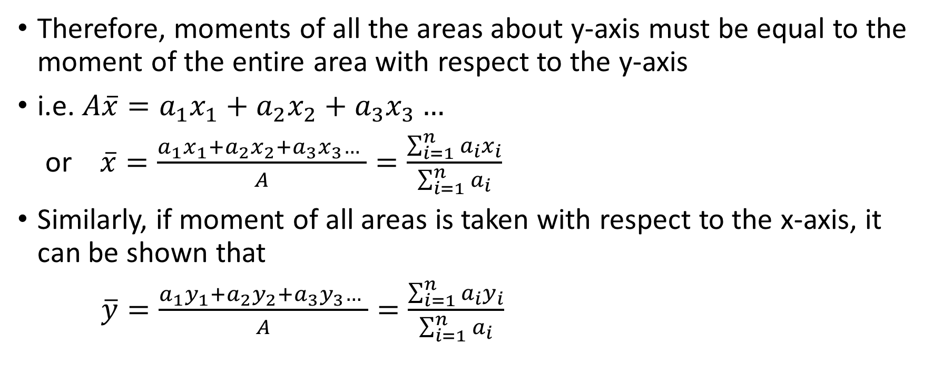
Locating the Centroid of an area (lamina)
Therefore, moments of all the areas about y-axis must be equal to the moment of the entire area with respect to the y-axis
i.e. $A\overline{x}=a_{1}x_{1}+a_{2}x_{2}+a_{3}x_{3}…$
or $\overline{x}=\frac{a_{1}x_{1}+a_{2}x_{2}+a_{3}x_{3}… }{A}=\frac{\sum_{i=1}^{n}{a_{i}x_{i}}}{\sum_{i=1}^{n}{a_{i}}}$
Similarly, if moment of all areas is taken with respect to the x-axis, it can be shown that
$\overline{y}=\frac{a_{1}y_{1}+a_{2}y_{2}+a_{3}y_{3}… }{A}=\frac{\sum_{i=1}^{n}{a_{i}y_{i}}}{\sum_{i=1}^{n}{a_{i}}}$

Slide 6
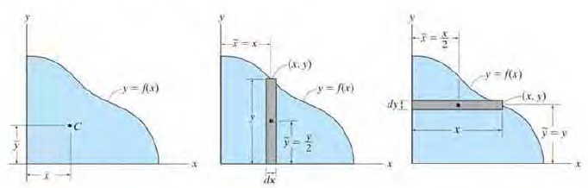
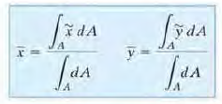
Locating the centroid of plane areas
If the area is defined by a function then the coordinates of the centroid may be located by integrating the function over the limits of the area

Slide 7
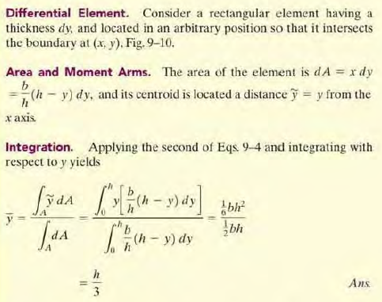
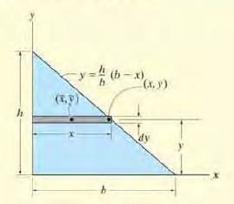
Centroid of a triangle
This result is valid for all triangles

Slide 8
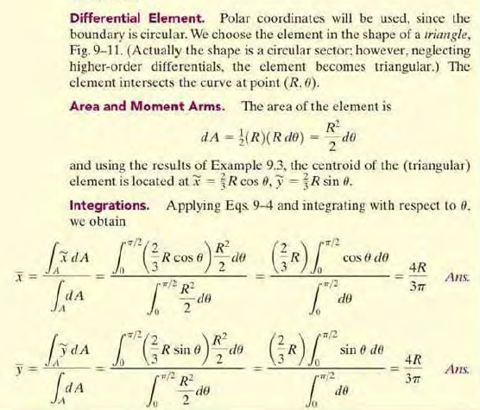
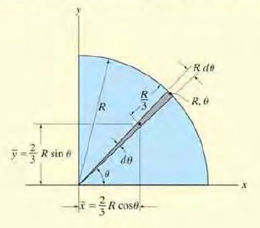
Centroid of a right-angled triangle

